Slide 1
Templated Search over Relational Databases
Date: 2015/01/15
Author: Anastasios Zouzias, Michail Vlachos, Vagelis Hristidis
Source: ACM CIKM’14
Advisor: Jia-ling Koh
Speaker: Han, Wang

Slide 2
Outline
Introduction
Problem Definition
Algorithm
Experiments
Conclusion

Slide 3
Introduction
Motivation:
Transaction data and past interactional data with clients offer worth information in enterprises.
Distill useful information is challenging.
3 factors:
Access Issues
Data Issues
Interface Issues

Slide 4
Introduction
Goal:
Propose a tree-based guide search query generation mechanism that combined the advantages of keyword search interfaces with expressive power of QA system.
TEmplated
Search
Paradigm
(TES)
Output:
Potential
Recommendation
Queries
Input:
Template Query
SQL
DB

Slide 5
Introduction
Interface:
Need not SQL and knowledge of schema.
static text : predefined.
dynamic text: retrieved from DB.

Slide 6
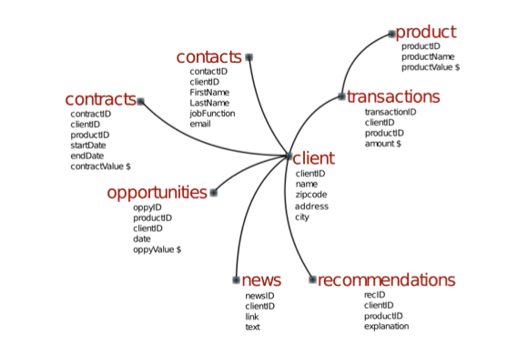
Introduction
Simplified database schema
static nodes
dynamic nodes
Input template queries

Slide 7
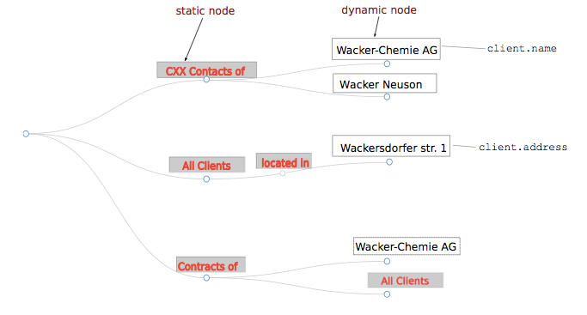
Introduction
Input query: “wacker”
Rank valid question/path: relevance, coverage and diversity
Match two records at attribute “name” of entity client and “address” of client.

Slide 8
Outline
Introduction
Problem Definition
Algorithm
Experiments
Conclusion

Slide 9
Problem Definition
Framework
TES
Generate list of valid question/path over the tree
Output:
top-k
Potential
Queries
Input:
Template
Query
Rank the valid path from criteria : relevance, coverage,diversity

Slide 10
Problem Definition
Query tree(QT): rooted directed tree T = (V , E)
v: static or dynamic node
q: query keywords
L(v,q): label function
static node u: L(u.q) = L(u)
q = ‘Wacker’, dynamic node u: L(‘Wacker’,u) = {Wacker-Chemie AG, Wacker Neuson…..}
p: path
Q: query
Valid path:
p matches at least one keyword in Q
remove the last node would decrease keywords

Slide 11
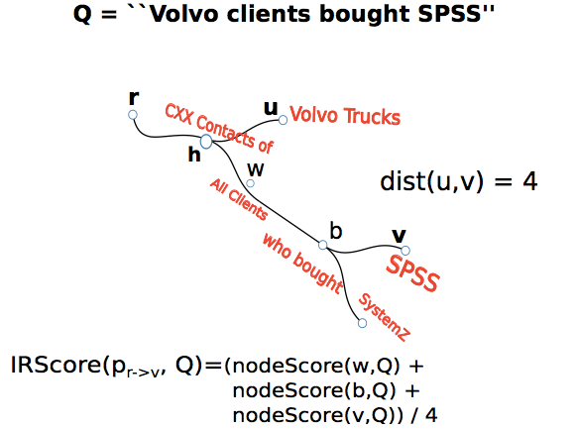
Problem Definition
Metric structure of paths:
p1 = root -> t1, p2 = root -> t2
nodeScore() : Okapi BM25
Relevance: IR relevance of path with respect to query
Coverage: importance of all descendants of sub-path

Slide 12
Problem Definition
Avoid generating the similar paths.
S: All paths , |S| = k
λ : parameter, tradeoff between relevance and diversity
Diversity: the dissimilarity or distance between two paths

Slide 13
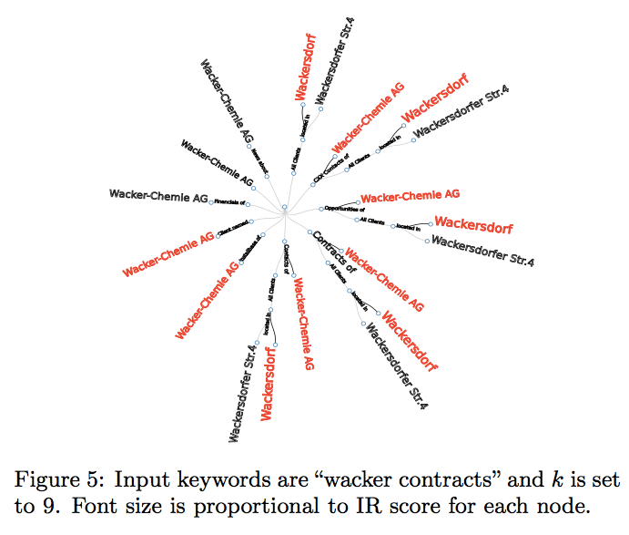
Problem Definition

Slide 14
Outline
Introduction
Problem Definition
Algorithm
Experiments
Conclusion

Slide 15
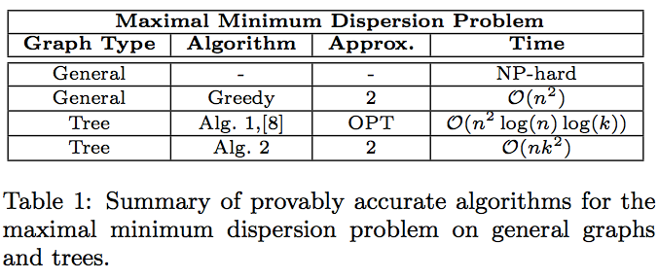
Algorithm
diversification problems -> dispersion problem(graph)
diversity path for tree:
top-k ranking of n paths(algorithm 1)
for restricted cases(algorithm 2)

Slide 16
Algorithm
rewrite MMR-Path Equation:
Given P, Let T = (V, E), e = (u, v) ∈ E
Define:
For graph
CovScore(pv,Q)
Result nodes of algorithm in a set of paths will maximize equation.

Slide 17
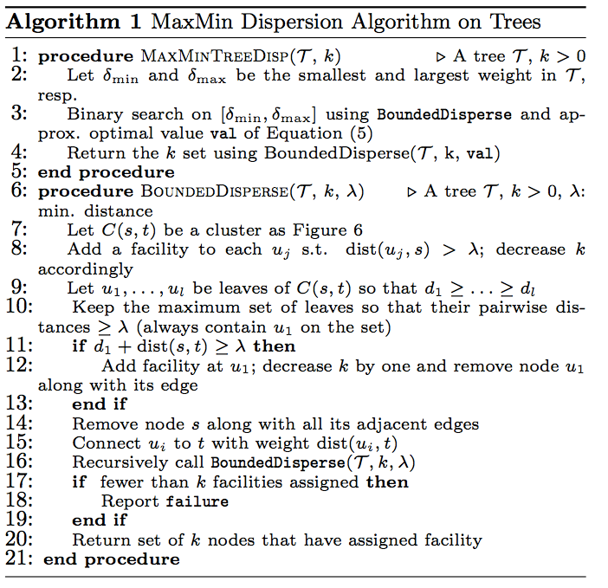
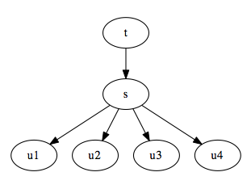
Algorithm
Maintain large number of paths
According to distance, to remove the faraway nodes
Connect t and u without s.

Slide 18
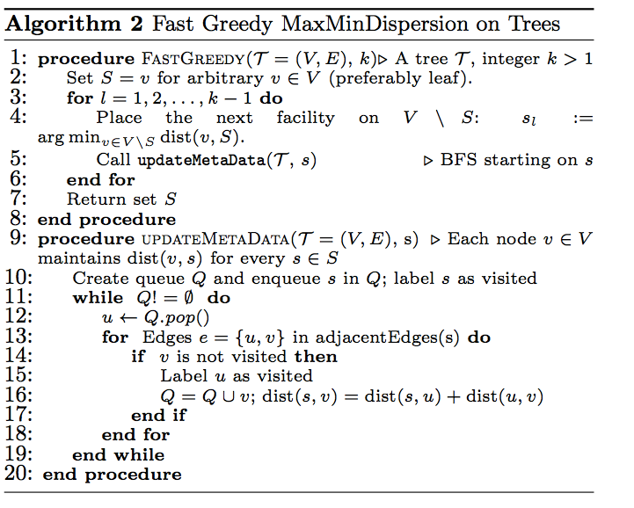
Algorithm
BFS

Slide 19
Outline
Introduction
Problem Definition
Algorithm
Experiments
Conclusion

Slide 20
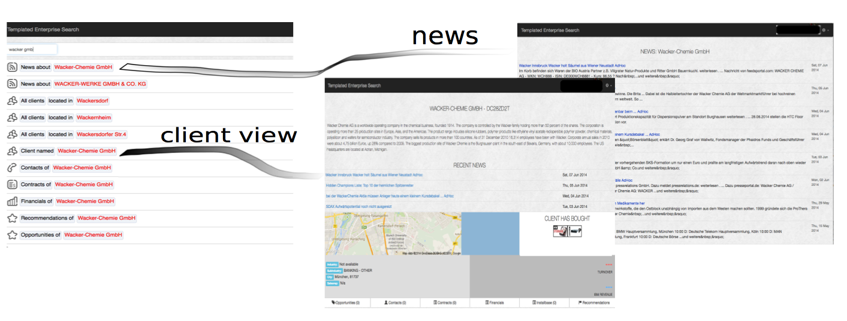
Experiments
Dataset:
real enterprise data
16 million indexed entities
20.2 GBytes

Slide 21
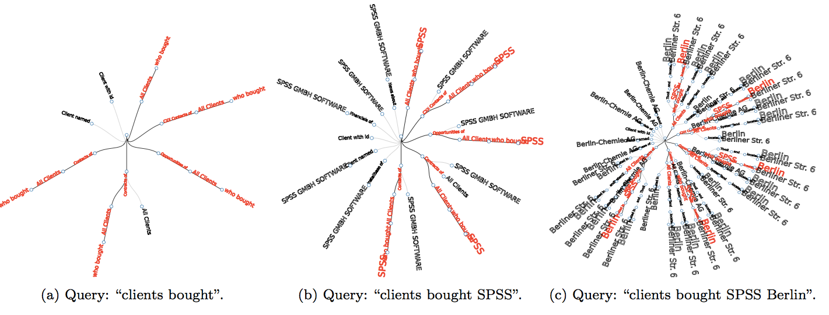
Experiments

Slide 22
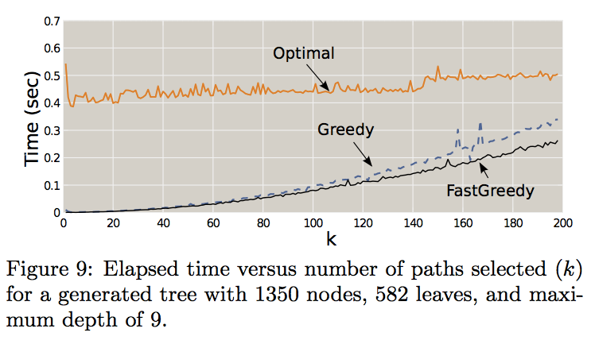
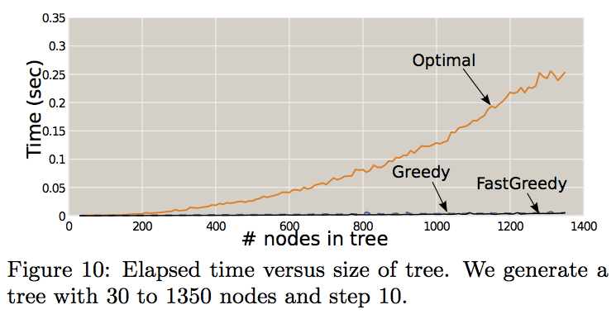
Experiments
Algorithms: Optimal(Algorithm 1), FastGreedy(Algorithm2), Greedy
K = 25

Slide 23
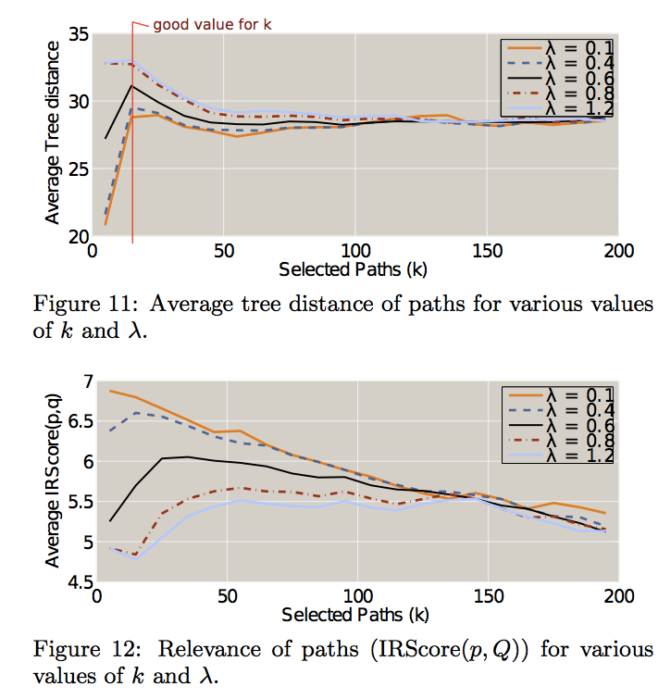
Experiments
FastGreedy
good value for k = 20
FastGreedy
fixed k, suggest λ ≈ 0.6

Slide 24
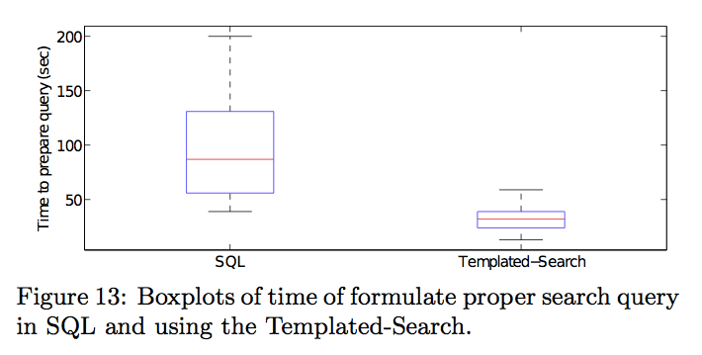
Experiments
User study:
15 questions
five technical users
SQL vs Templated-Search

Slide 25
Outline
Introduction
Problem Definition
Algorithm
Experiments
Conclusion

Slide 26
Conclusion
Tree-based question generation framework based on IR and graph theoretical.
Two accurate optimal scalable algorithms for path diversification over rooted tree.
SQL supports: multi-way join, selection, projections, unions, intersections and exclusion over sets and ordering.
Future work: Add “Group by” and aggregate queries operation.

